Slide 1

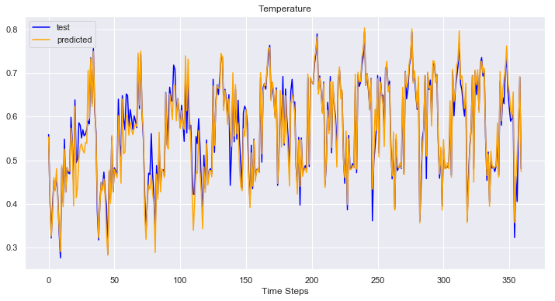
Deep Neural Network for Weather Time Series Forecasting
Nishi Gupta
Springboard Data Science Career Track,
Capstone Project 2

Slide 2
Introduction
Forecasting Time series – popular in nearly all science, engineering and real world applications.
Deep Learning models perform best with massive dataset.
Not all time series problems have massive dataset available.
Because of nature of Time series analysis, two values of the same feature in two different time steps are considered as different features, the data size available for processing becomes larger and complicated.
Can Deep Learning Model perform good on medium size time series data set?

Slide 3
Weather Forecast
One of the most popular forecast problems.
Forecast Temperature, Pressure, Humidity, Wind Direction and Wind Speed.

Slide 4
Time Series Analysis
A sequence of numeric data observations collected over a period of time at regular intervals.
Univariate Time Series.
Multivariate Time Series.

Slide 5
Machine Learning For Time Series Analysis
Wide variety of high performance Machine Learning Models.
Eg. LinearRegression, RandomForest, XGBRegressor, Auto Regressive Integrated Moving Average (ARIMA)
Non-Linear models such as RandomForest and XGBRegressor perform better for time series analysis.

Slide 6
Historical Hourly Weather Dataset
Link to Dataset: https://www.kaggle.com/selfishgene/historical-hourly-weather-data
The dataset contains ~5 years of high temporal resolution i.e. hourly measurements of six weather attributes: temperature, humidity, air pressure, wind direction, wind speed of 36 cities.
The dataset also has non temporal data, the location of each city in terms of longitude and latitude.

Slide 7
Deep Neural Networks
Deep Learning is the general term for a series of multi-layer architecture neural networks.
Several Deep Learning models for time series analysis, such as Recurrent Neural Networks (RNN), The Long Short Term Memory (LSTM) neural network, Gated Recurrent Units (GRU), Stacked Auto Encoders, Multi-layer Perceptron (MLP) Regression.
Vanishing/Exploding Gradient Problem: LSTM and GRU solve this problem.

Slide 8
The Long Short Term Memory Networks
Introduced by Hochreiter & Schmidhuber (1997).
Remembering information for long periods of time is practically the default behavior of LSTM networks, not something they struggle to learn!
Block Diagram of LSTM Cell

Slide 9
Deep LSTM-MLP Model
A multi-variate prediction model that learns the relationships of the temporal weather variables such as temperature, pressure, humidity, wind direction and wind direction and non-temporal variables such as latitude and longitude of locations of cities using hourly historic data of 36 different cities.
Stacked layers of LSTM and MLP models, Batch Normalization layers and Dropout layers.
Uses Adam Optimizers, ReLU Activation function, Glorot Weight initialization

Slide 10


Temporal inputs
Input Layer
Hidden Layer 1
Hidden Layer 2
Hidden Layer 5
MLP - Hidden Layer 6
MLP - Hidden Layer 7
FC
Batch Normalization
Dropout
Batch Normalization
Dropout
Batch Normalization
Dropout
x₁
LSTM Cell
LSTM Cell
LSTM Cell
x₂
FC
Output
LSTM Cell
LSTM Cell
LSTM Cell
x₃
FC
LSTM Cell
LSTM Cell
LSTM Cell
x_{n}
FC
LSTM Cell
LSTM Cell
LSTM Cell
l₁
Non Temporal Input
l₂
Block diagram of LSTM-MLP Deep Neural Network

Slide 11
Results Metrics
Mean Square Error (MSE) used as Loss value for optimization.
RMSE (Root Mean Square Error), Mean Absolute Error (MAE) and Mean Absolute percent Error (MAPE) are different metrics used for comparing results of different models.

Slide 12
Experimental Details
Weather features have physical properties and are related to each other such as temperature and pressure are inversely proportional to each other, wind has speed and direction so can be represented by a vector.
I considered these as data and relationship among them is not considered during the analysis.
The data is normalized with zero mean and unit variance.
We perform 6 step ahead prediction for all the variables for univariate analysis and multivariate analysis.

Slide 13
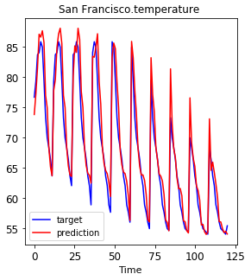
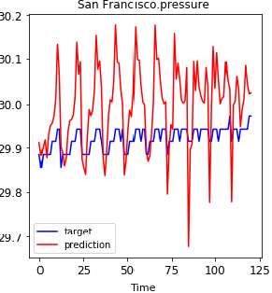
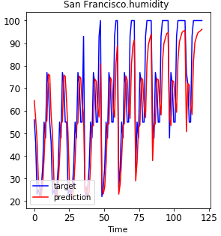
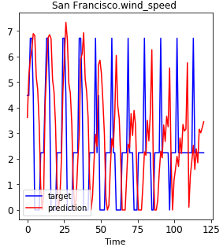
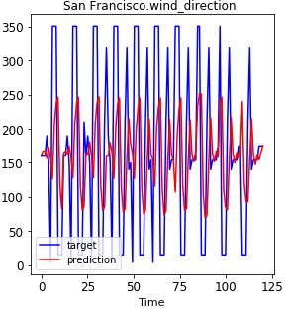
Qualitative Predictions
The Prediction plot for multivariate LSTM-MLP model of all 5 weather features for San Francisco from the weather dataset are shown below.
The plot below show that Pressure and Wind Direction had higher variance and really low variance respectively and these were hard to predict.
Temperature, Humidity and Wind Speed were relatively smooth and were easy to predict.

Slide 14
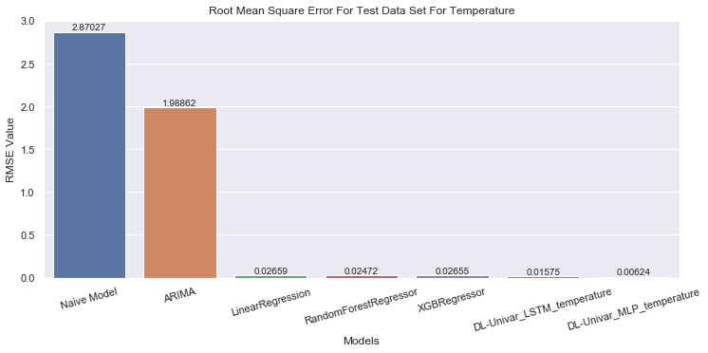
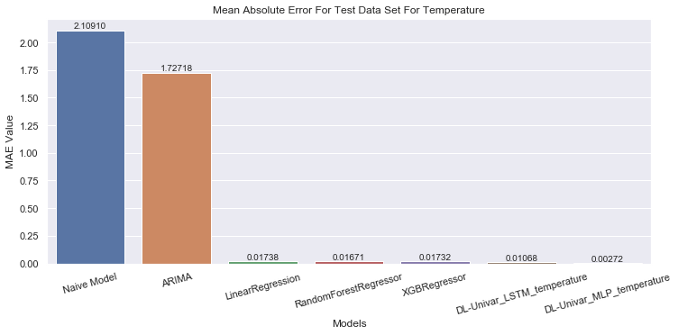
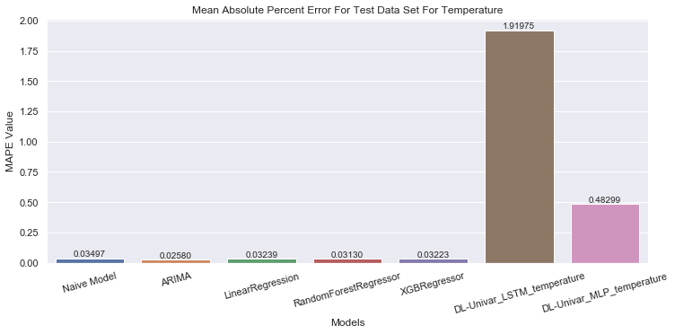
Aggregate Quantitative Performance
Uni-Variate Analysis Results:
Figures below shows the values of RMSE, MAE and MAPE for uni-variable analysis of Temperature.
Deep Learning models Multi-Layer Perceptron (MLP) and Long Short Term Memory (LSTM) performed better Machine Learning Models for RMSE and MAE.

Slide 15
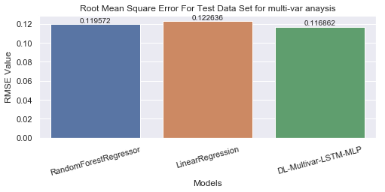
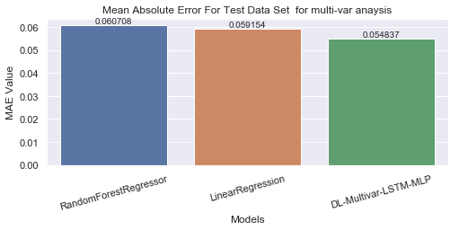
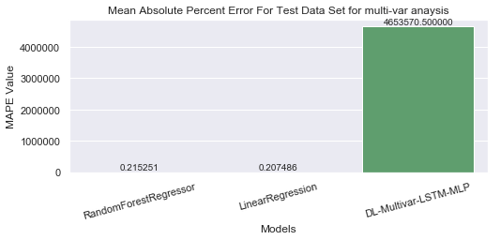
Multi-Variate Analysis Results:
Figures below shows the values of RMSE, MAE and MAPE for multi-variable analysis of 5 weather features.
Deep Learning model LSTM-MLP performed better than Machine Learning Models for RMSE and MAE.

Slide 16
Conclusion
In this work, I presented a new model, LSTM-MLP, for multivariate time-series prediction by combining the multiple layers of LSTM cells and multiple layers of MLP layers.
The idea is to use multiple LSTM layer to capture long term and short term memories of temporal weather data. Then combine that memory of non-temporal data in MLP layers to generate final predictions.
I compared the results with several Machine Learning models. Both LSTM model for univariate and LSTM-MLP model for multivariate analysis performed better than traditional machine learning model.
As I increase the number of steps ahead I want to make the predictions, the complexity of the model and time require to train the model increases.
Deep Learning models with distributed networking perform better and make analysis faster.

